Slide 1
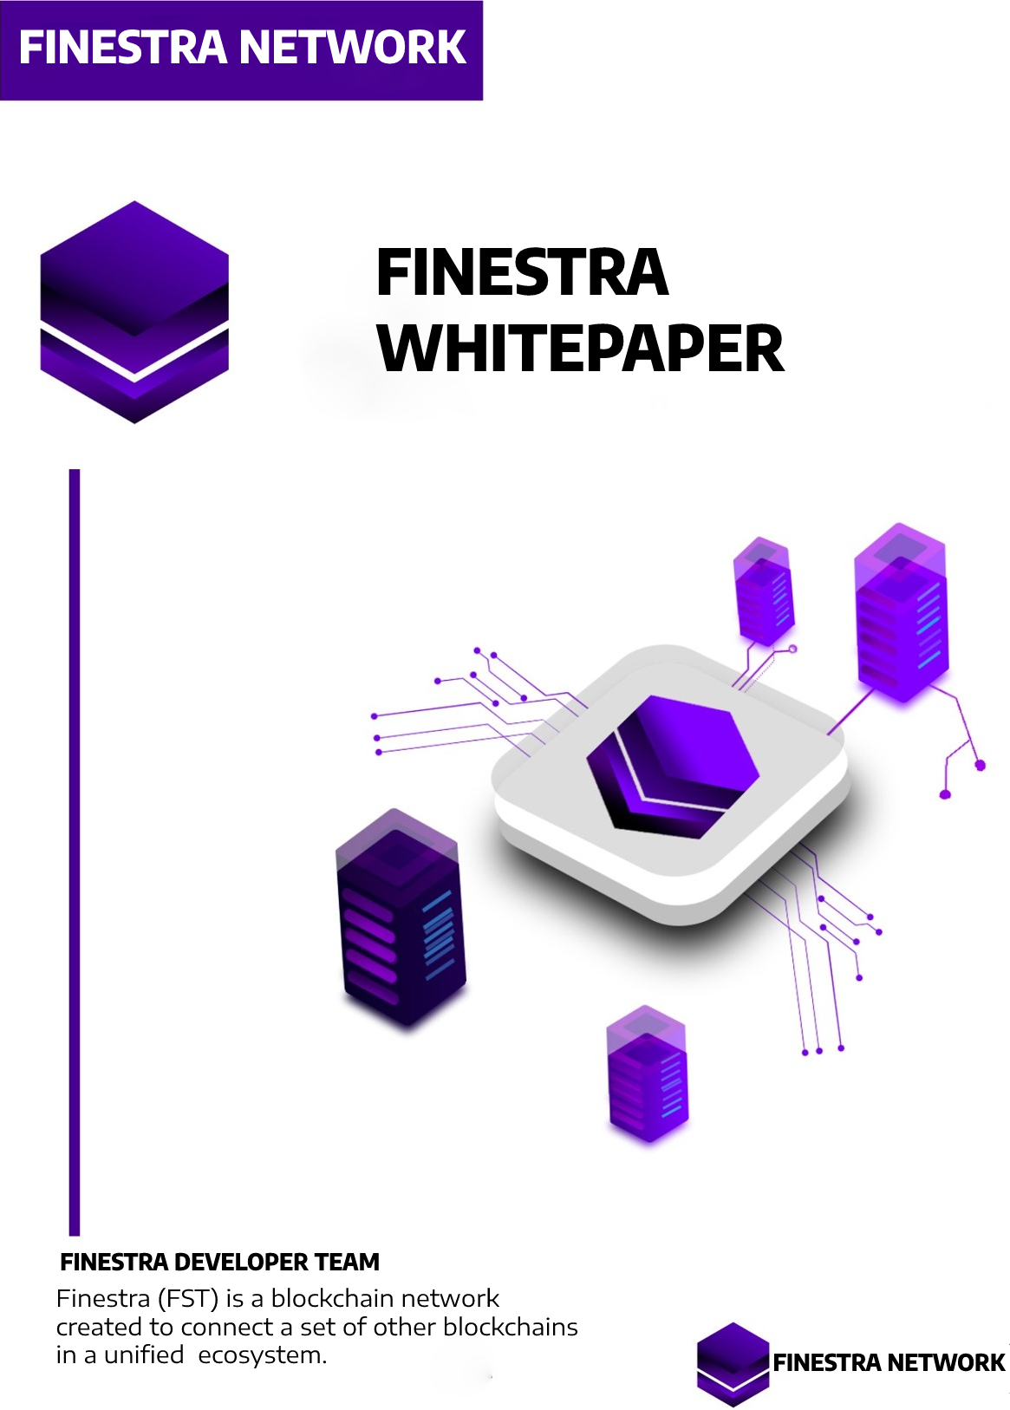

Slide 2

FINESTRA BLOCKCHAIN PROJECT
Finestra is a new blockchain network that aims to connect a set of other blockchains in a unified ecosystem using Ethereum technology. The network uses ERC20 as its programming standard and a proof-of-stake consensus mechanism called Nominated Proof-of-stake (NPOS).
The Ethereum Technology
Ethereum technology allows various developers to create their own applications and blockchains on top of Finestra. Substrate is the programming application built specifically for Finestra and its features, which is similar to the Ethereum SDK for the Ethereum ecosystem.
The Nominated Proof-of-stake (NPOS) Consensus Mechanism
Validators secure the Relay Chain by staking tokens (FST).
If selected to be active validators, they validate transactions from collators on Ethereum and generate blocks on the Relay Chain.
Nominators also contribute to network security by staking FSTs to validators they trust in order to be voted on by the network.
Collators collect Ethereum transactions and provide proofs for validators in the Relay Chain.
They can also send and receive messages from other Ethereum using cross-chain message passing (XCMP).

Slide 3
The Finestra Improvement Proposal (EIP) Process
The governance system of Finestra is called the Finestra Improvement Proposal (EIP) process, which is similar to the Ethereum Improvement Proposal (EIP) process. FST coin holders can vote on proposals to upgrade the network or make changes to its parameters. This governance system allows for community-driven decision making, which ensures that the network remains transparent and efficient.
Advantages of Finestra
Multi-chain architecture: Finestra's multi-chain architecture allows for scalability and interoperability between different blockchains. By using Ethereum technology, developers can create their own blockchains on top of Finestra, which can then interact with other Ethereums within the network.
Energy-efficient: The staking scheme used by Finestra for transaction validation makes the network more energy-efficient compared to proof-of-work (POW) systems like Bitcoin.
Community-driven decision making: The Finestra Improvement Proposal (EIP) process allows for community-driven decision making, ensuring that the network remains transparent and efficient.
Summary
In summary, Finestra is a new blockchain network that utilizes Ethereum technology to connect different blockchains into a unified ecosystem. Its proof-of-stake consensus mechanism, Nominated Proof-of-stake (NPOS), involves validators, nominators, and collators. The Finestra Improvement Proposal (EIP) process is its governance system, which allows for community-driven decision making. Finestra's multi-chain architecture, staking scheme, and governance system make it more scalable, interoperable, and energy-efficient than other blockchain networks.

Slide 4
Finestra is a unique blockchain network that stands out due to its ecosystem of blockchains that can connect and interact with each other, creating unlimited interoperability between all crypto assets on the network. It also uses a shared security system, enabling each blockchain to focus on its own projects without worrying about security. Additionally, Finestra offers the same transaction speed and fees as other POS networks.
Unique Governance System
Finestra distinguishes itself in the way governance is organized. Unlike other cryptocurrencies where upgrading the blockchain can be difficult and slow, often resulting in a hard fork, Finestra uses a transparent and decentralized governance mechanism where users have power. Finestra calls this "user-driven network governance" or "user-driven network management." This system ensures that the network remains efficient and transparent, avoiding the potential for community divisions that can result from hard forks in other blockchain networks.
FSTS as a Special Commodity
Finestra's governance system also gives FSTS owners a significant say in determining various aspects of the network, such as voting in Ethereum auctions and selecting Ethereum common goods. FST is a special commodity of the Finestra ecosystem.
Transaction Speed and Fees
Finestra offers the same transaction speed and fees as other POS networks, such as Cardano, Fantom, and Solana. This ensures that users can carry out transactions quickly and affordably, making Finestra an attractive option for those seeking efficiency.
Shared Security System
Finestra utilizes a shared security system, where the core relay chain network is responsible for the security of the entire ecosystem. This system allows each blockchain to focus on its own projects without worrying about security, ensuring that the network remains secure and efficient.

Slide 5
How does the Finestra Blockchain work?
Blockchains can connect with Finestras in a parallel way because Ethereums can be added or removed. Ethereums can be public, private or other sources.
Data on the Ethereum network is accessed through specialized nodes known as collators, and will later be sent to Finestra. Then, the main chain in this crypto asset is known as relaychain which can support smart contracts.
The following is an explanation of the components in the Finestra network:
RELAYCHAIN: The Relay Chain is where the transaction will be finalized. All supporting data for the transaction will be checked so that each system can understand it.
Ethereum: A specialized blockchain that uses relay chain computing resources to confirm that transactions are accurate.
BRIDGES : Bridges allow the Finestra network to interact with other blockchains.In addition, there are several other components in the network that can keep the blockchain system operating, namely:
1. | Validator, whose function is to lock the FST token, validate the collator's proofs and participate in the consensus.
2. | Nominators, which lock FST tokens and secure the relaychain by selecting trusted validators.
3. | Collator, which collects transactions and creates proofs for validators.

Slide 6
Advantages of Finestra Blockchain:
Finestra offers a number of advantages that are not to be missed. Below are the benefits of Finestra.
1. | Specialization Each Ethereum Finestra can be customized to a specific use case or application.
2. | Upgrade without fork Finestra can be updated without the need for a hard fork, which can be a time-consuming process, so this new feature can be added without completely changing the network.
3. | Scalability Finestra heavily supports blockchain networks through a mechanism called "sharding" or Ethereum. This allows transactions to be processed efficiently and in parallel.
4. | Interoperability All Ethereum and Finestra applications can share information and functionality thanks to interoperable project design and network compatibility.

Slide 7
Blockchain Finestra Technology
Finestra develops blockchain technology that prioritizes the security and convenience of its users, ensuring high security and creating a breakthrough for long-term development.
High security
Focus on user convenience
Long-term development
Security Model
Finestra lets blockchains pool their security, ensuring that the network is protected from attacks and has a significant community to support it.
Security pooling
Protection from attacks
Community support
New Generation Proof of Stake
Finestra uses Nominated Proof of Stake (NPOS), enabling greater decentralization and fair representation by evenly distributing shares. FST coin holders can participate in staking as nominators or validators, and anyone with as little as 100 FST coins can stake and collect rewards.
Nominated Proof of Stake (NPOS)
Decentralization and fair representation
Participation for all FST coin holders
Energy-Efficient Protocol
Finestra's use of Proof of Stake consensus makes the blockchain energy efficient, reducing its impact on the environment.
Proof of Stake consensus
Energy efficiency
Environmental friendliness

Slide 8
Finestra TECHNOLOGY ECOSYSTEM
We will create an ecosystem in our network independently by relying on the latest technology that we develop for the future, taking into account a very sophisticated security system and being considered by blockchain experts and experts in the Finestra Blockchain core team.
In essence, we do not rely on projects under our network to become the core ecosystem when we are established but that does not mean we do not need innovation, but we have full control in developing all what we create for the future development of Finestra.
1. | Finestra DEFI (Finestra DEFI)
2. | CRYPTO WALLET (EVEWALLET)
3. | Finestra BLOCKCHAIN (Ethereum)
4. | Finestra NFT MARKET PLACE
5. | Finestra GAME-FI
6. | Finestra AUDIT PLATFORM
We focus all Finestra blockchain ecosystem by managing our own management to maintain the stability of highly sensitive security to avoid losses or other hacking techniques.
If in the future our ecosystem experiences losses due to hacking attacks or things that have the potential to bring down the project the price stability and asset holders remain safe, this is the reason we prioritise an independent ecosystem for the initial issuance of our blockchain.
The core team of the Finestra project are experts in managing the field of WEB3 security and various cyber systems, so we believe we take great care of everything we create to maintain the trust of investors and developers using our blockchain as a safe place.

Slide 9
ABOUT Finestra BLOCKCHAIN
Maximum Supply | 1.000.000.000 FST COIN Overall supply circulation
Transaction Speed | 6500 TPS
Transaction Finality | 3-4 Seconds
Scalability | Not Very Scalable
Node Count | 1300 Nodes
Storage Cost | *Not Decided Yet*
Energy Efficiency | *Not Decided Yet*
End User Management | User need to manage their own keys
Consensus | Proof Of Stake
Language | Solidity
Smart Contract | YES
Number of Validator | 3500 Per Subnet
Information(*):
Maximum supply Our circulating tokens remain 1,000,000,000 regardless of whether the tokens are in circulation and on any network exchange (BSC, ETH etc) our supply remains at 1,000,000,000.
Storage Cost We are currently discussing
Energy Efficiency are currently discussing
Note:
This is not our finalised result and we have not done any experiments to ensure the quality of our blockchain until testnet.
We will provide updates on our blockchain quality report through Finestra's social media and support platforms.

Slide 10
About Finestra Defi
Finestra Defi was inspired by a post made by Ethereum founder Vitalik Buterin and is supported on four major blockchain networks, including BNB CHAIN, Ethereum, Matic, and Finestra Chain.
Inspired by Vitalik Buterin
Supported on major blockchain networks
Finestra Defi Features
Finestra Defi is a decentralised exchange (DEX) that facilitates exchange transactions on supporting networks and the Finestra Network, without incurring platform or intermediary fees. It uses mathematical equations, token pools, and FST to match buyers and sellers to determine prices and conduct trades.
Decentralized exchange (DEX)
No fees
Mathematical equations for matching buyers and sellers
Finestra Defi Development
Finestra Defi offers several features to its users, including Swap, Liquidity, Farming, Staking, and an NFT Marketplace.
Swap: Supported network token exchange
Liquidity: Project developers can put or create liquidity on the platform
Farming: Users can earn passive income with Finestra
Staking: FST token holders can double their assets through staking
NFT Marketplace: A marketplace for conducting business turnover of NFT assets with the support of several networks

Slide 11
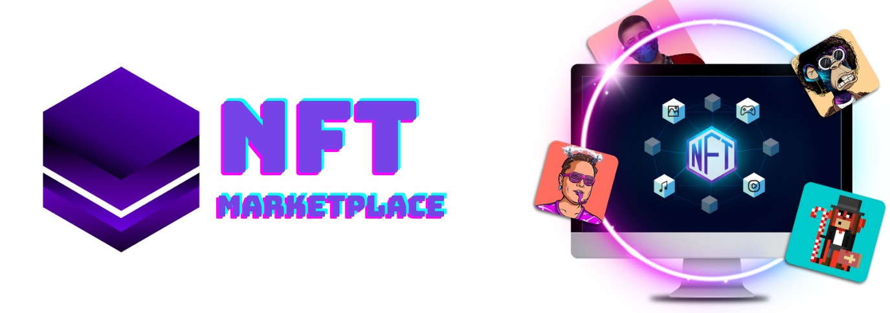
About Ever NFT Marketplace
Ever NFT Marketplace is an online marketplace for buying and selling NFTs (Non-Fungible Tokens). NFTs are digital assets on the blockchain network that have unique identification codes and metadata, representing a variety of tangible and intangible goods that are considered unique and rare.
Online marketplace for buying and selling NFTs
Unique digital assets on the blockchain network
Use of Ever NFT Marketplace
Ever NFT Marketplace is the first NFT marketplace developed by the Finestra team, with more than 10 million NFTs supporting various items such as photos and videos. The platform allows NFT owners or sellers and collectors or buyers to transact.
Developed by Finestra team
10 million NFTs supporting various items
Platform for NFT owners and collectors to transact
Supported Payment Tokens
The majority of NFT trading on Ever NFT Marketplace supports FST, ETH, BSC & Polygon, but the core currencies that will be exchanged in the future are BNB, ETH, MATIC & FST, as well as stable coins such as BUSD, USDT & USDC. Other payment token supports, such as $BNB and $ETH, are also available. However, it is a future goal for Ever NFT Marketplace to use non-crypto currencies such as USD and Euro.
Multiple payment token supports

Slide 12
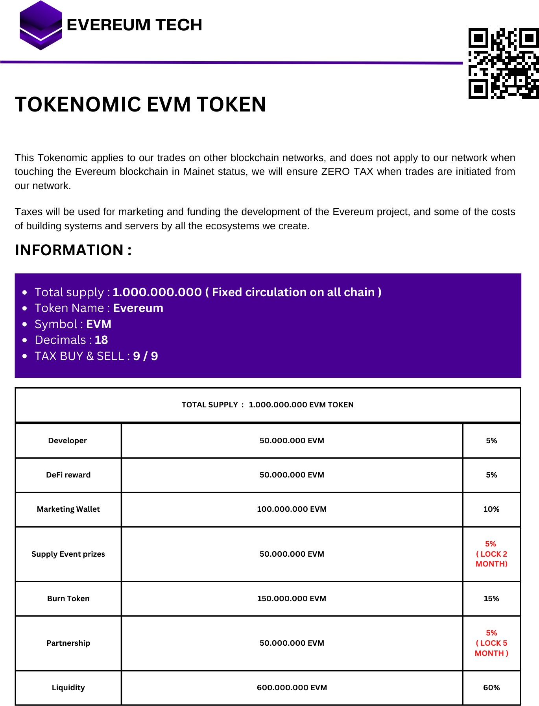

Slide 13
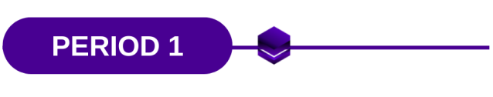


CORE CONCEPT DESIGN
OFFICIAL WEBSITE DESIGN
OFFICIAL WHITEPER DESIGN
OFFICIAL CONTRACT SMART DESIGN (ETH NETWORK)
OFFICIAL WEBSITE LAUNCH
MARKETING PLANNING (FOR AFTER LAUNCH)
CREATE OFFICIAL COMMUNITY TELEGRAM
LAUNCH TOKEN ON ETH CHAIN (UNISWAP)
COMMUNITY CONTEST (TELEGRAM & TWITTER)
PUBLIC TESTNET BLOCKCHAIN CREATE
PUBLIC FAUCET TESTNET LAUNCH
TESTNET BLOCKCHAIN EXPLORER LAUNCH
MARKETING RUNNING
DEFI TESTNET LAUNCHING (SWAP, STAKING, FARMING)
VERIFICATION LOGO ON ALL PLATFORM

Slide 14
